Slide 1
Product Enablement Series
Recovery Best Practices for x360Recover Direct-to-Cloud
January 18, 2023
Notes:
Welcome to Axcient’s product enablement webinar series.
This session is Recovery best practices for D2C.

Slide 2
Product Enablement Webinar Series
In-depth best practices shared by Axcient product experts, with detailed demos
Focus on getting the most from your Axcient investment
Third Wednesday of the Month
Time: 1:00pm Eastern / 12:00pm Central / 11:00am Mountain / 10:00am Pacific
January 18—Recovery Best Practices for x360Recover Direct-to-Cloud
February 15—Evaluation and Configuration of an Appliance (Axcient or any other appliance)
March 15—Protecting Linux-based Systems

Slide 3
Your Axcient Subject Matter Experts
Leif Fortson
Sr Product Manager
Jeff Crystal
Product Owner

Slide 4
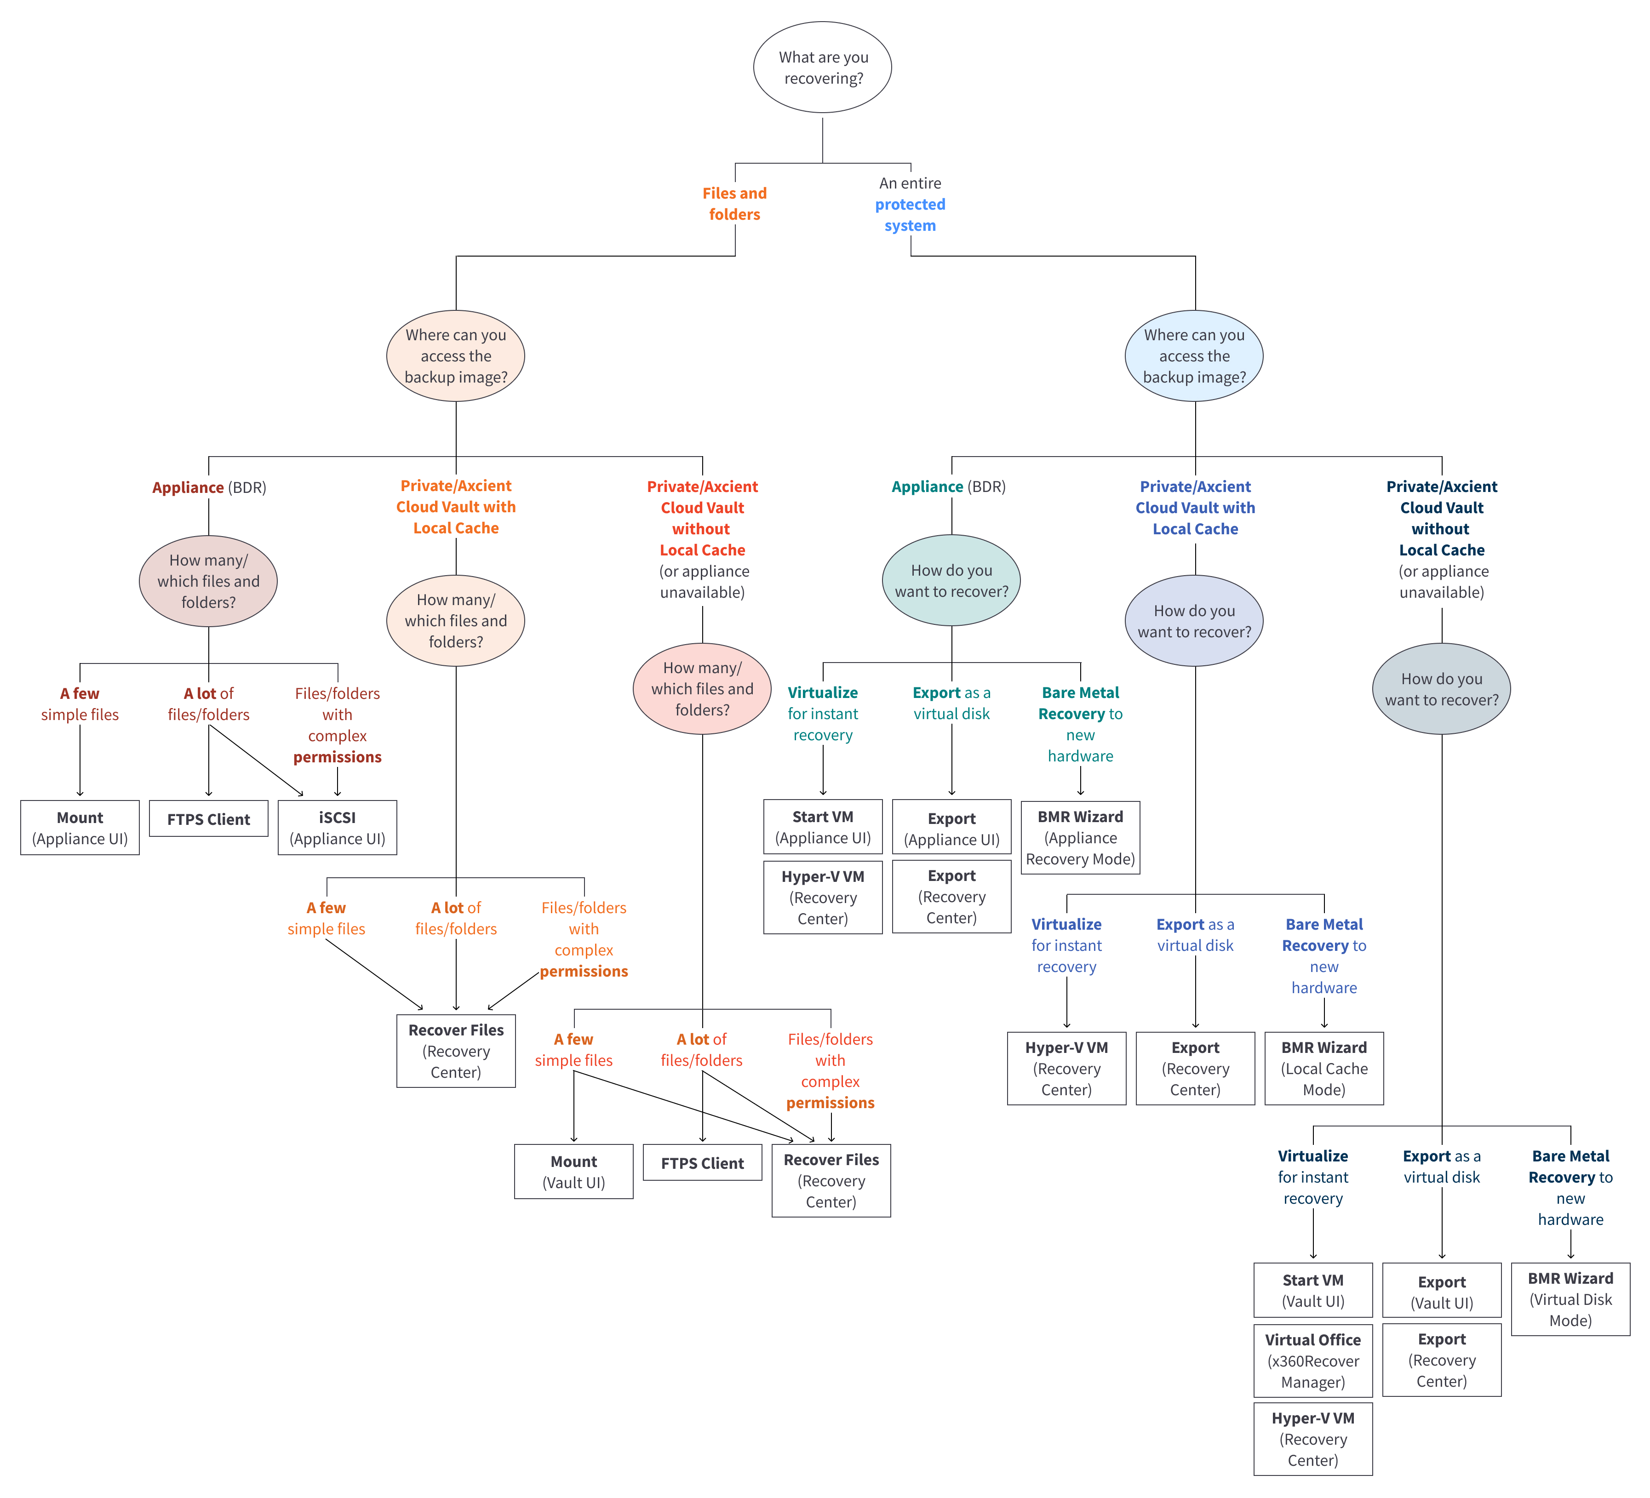
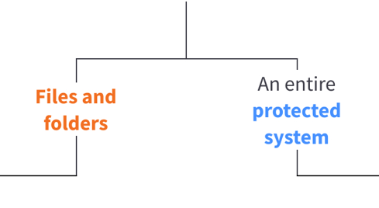
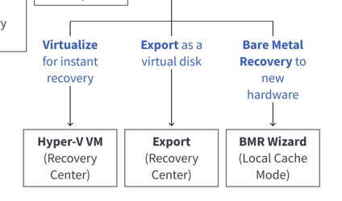
x360Recover Recovery Options

Slide 5
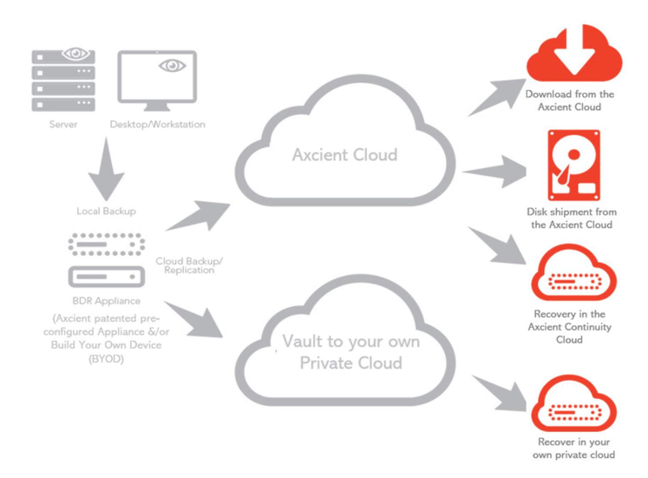
Data Recovery Methods
Variety of Methods
Not all data loss scenarios are the same, having a variety of options to choose from helps reduce recovery time.
WHY
Data Recovery Types
Virtualize
Virtual Disk Exports
File & Folder Recovery
Bare Metal Restore

Slide 6
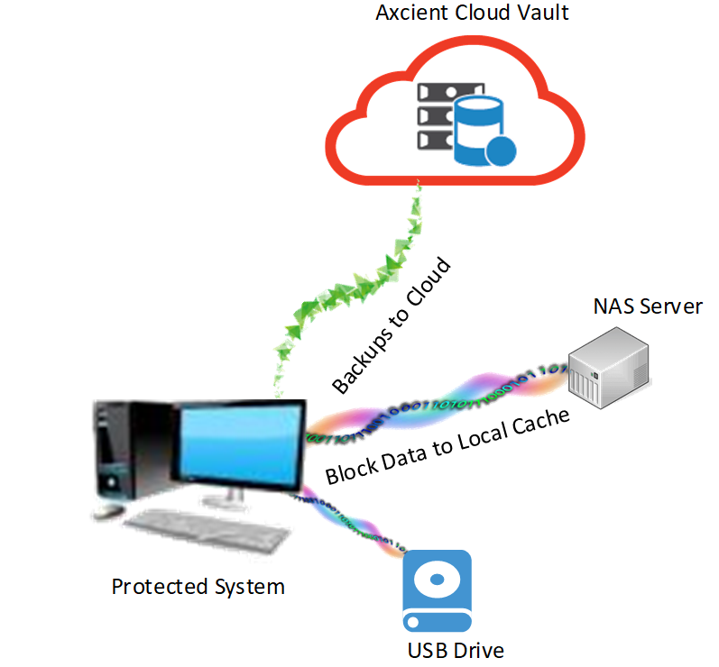
Recovering with Local Cache
Local Cache
Fast and real-time recovery w/o an appliance hardware
WHY
Faster failback after virtualization
Faster file download/transfer for large datasets
Client willing to pay lower cost for local backup

Slide 7
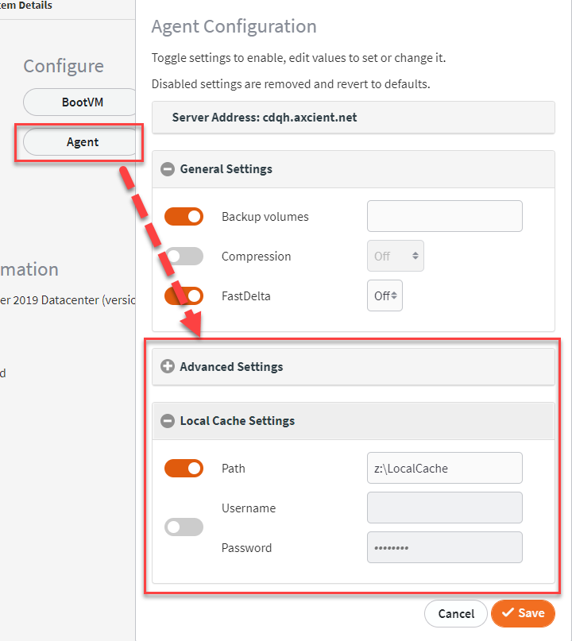
Enabling Local Cache
Enable local cache for your D2C protected system
Set your local cache locally for the protected system or a shared storage such as a NAS device
Set a strong username and password to strengthen authentication

Slide 8
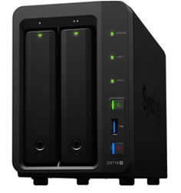
Benefits for a Shared Storage for Local Cache
De-duplication of data from protected systems
Easier to maintain storage management (less storage requirements)
Easier to maintain authentication
More secure than being on the same protected system

Slide 9
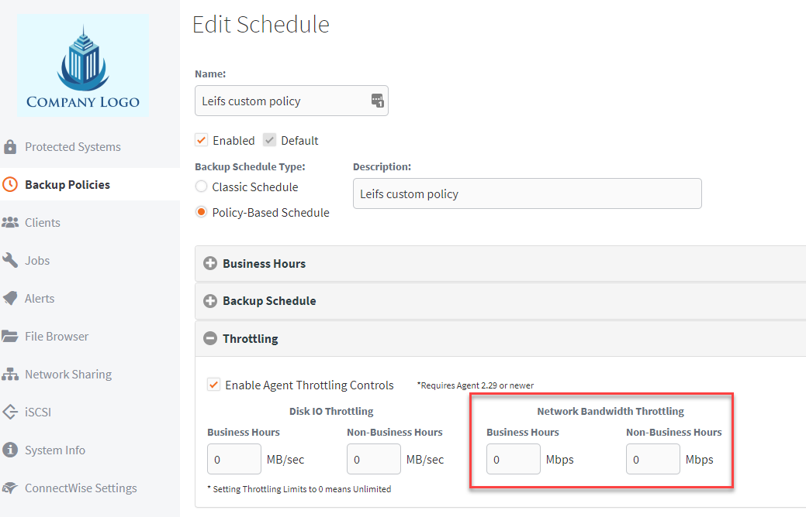
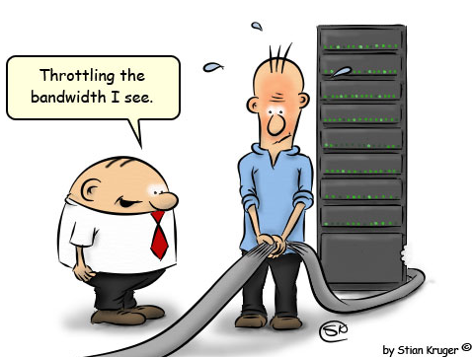
Network Bandwidth Throttling
Manage policies via backup schedules
Manage network congestion

Slide 10
Recovery Demos

Slide 11
Questions
?

Slide 12
Free Trials
axcient.com/trial-signup
Notes:
See a demo, start a trial

Slide 13
Keep business running.
CURE DATA LOSS

